Slide 1
Maurice Bourquin
CERN, June 13, 2016
The book contains all the contributions from the conference (more than 80)
Now available
Anybody with a CERN account can access the proceedings online from the Springer site

Slide 2
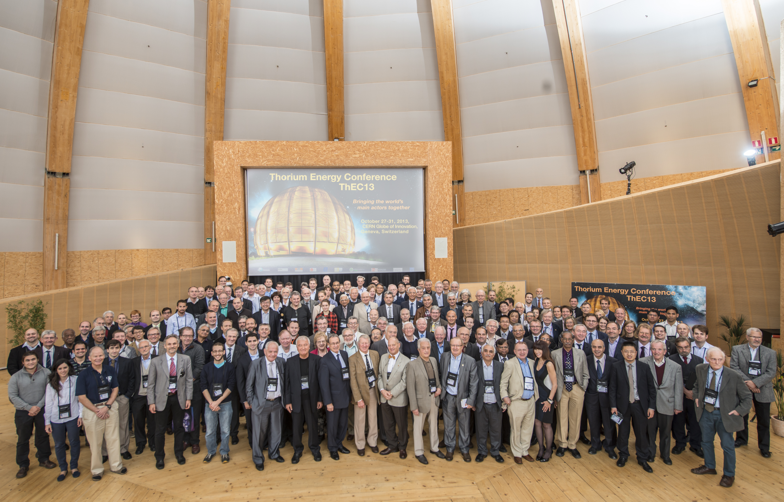
200 participants, including Hans Blix (IAEA), Hongjie Xu (MSR China), Anil Kakodkar (AEC India)…
Notes:
Former director general of International Atomic Energy Agency , Head of China MSR Project, Former Chairman atomic Energy Commission of India.

Slide 3
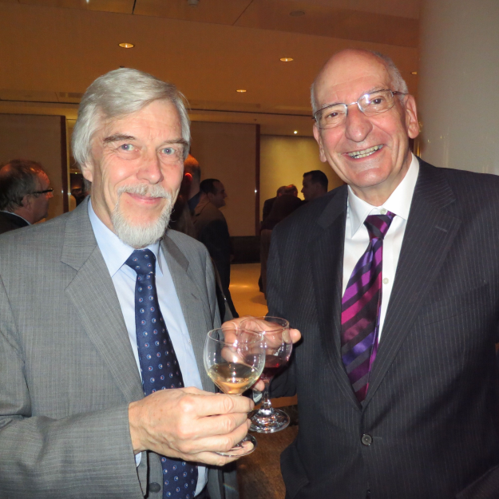
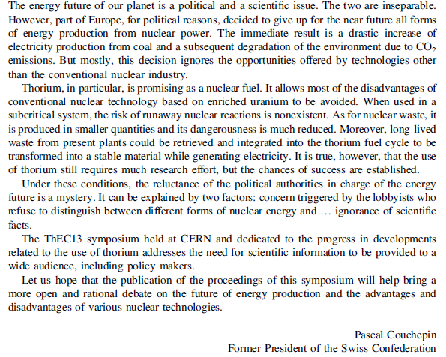
Political perspective
←
←

Slide 4
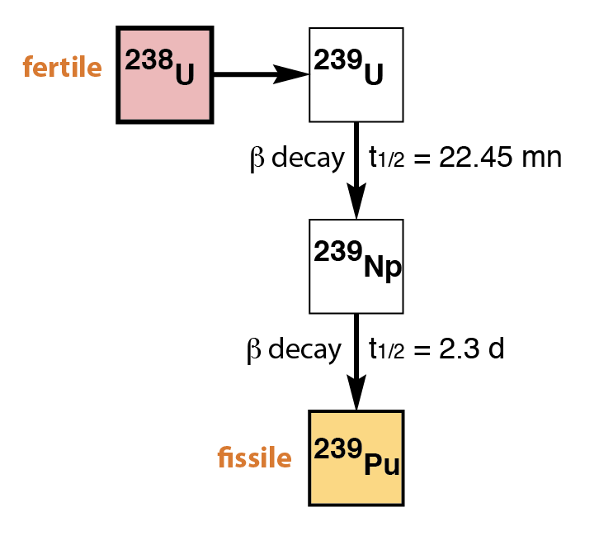
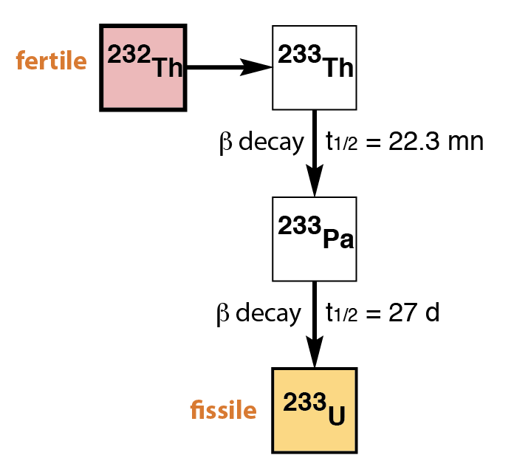
What is fission energy from ²³²Th₉₀ ?
Thorium is fertile, not fissile, so it can ONLY be used in breeding mode, by producing ²³³U, which is fissile . In the reactor the fuel is almost completely used up.
The fact that most of the thorium is used gives a factor 140 gain compared to ²³⁵U in PWRs (with the factor 3 to 4 in abundance, overall factor 500)
Neutron Capture
Factor 11!
Uranium chain
Thorium chain
Notes:
three major isotopes, uranium-238 (99.2739 - 99.2752% natural abundance), uranium-235 (0.7198 - 0.7202%), and uranium-234 (0.0050 - 0.0059%).[5]

Slide 5
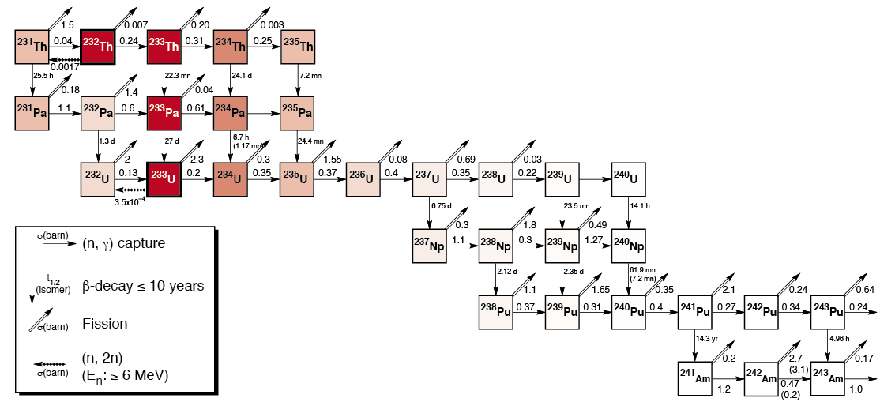
Destroying nuclear waste with ²³²Th₉₀
Thorium minimizes nuclear waste production, as it is 7 neutron captures away from ²³⁹Pu
For the same reason, it can be used to destroy nuclear waste (transuranic elements) with efficient recycling and a fast neutron flux in the reactor
Entry door to nuclear waste production
TRU
Notes:
three major isotopes, uranium-238 (99.2739 - 99.2752% natural abundance), uranium-235 (0.7198 - 0.7202%), and uranium-234 (0.0050 - 0.0059%).[5]

Slide 6
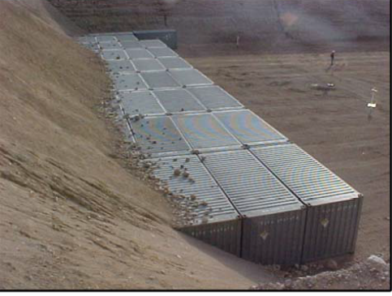
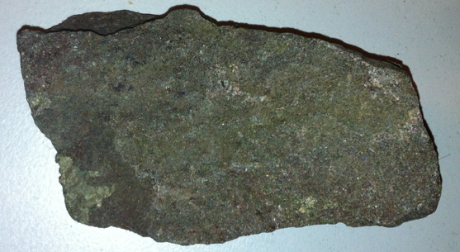
Proceedings Scientific Part: Opening Talks A Future for Thorium Power?
“Thorium is a sustainable source of energy on a human time scale” Carlo Rubbia
Thorium only used in breeding mode.
In contrast with Uranium (which may also be used in breeding mode):
– 4 times larger supply
– produces less wastes
– less proliferating
– safer
Containers of thorium nitrate in Nevada
Monazite sample

Slide 7
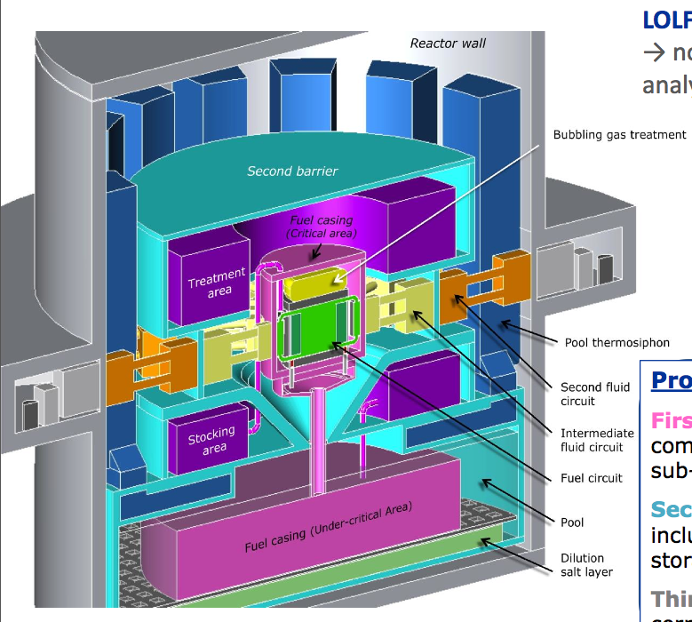
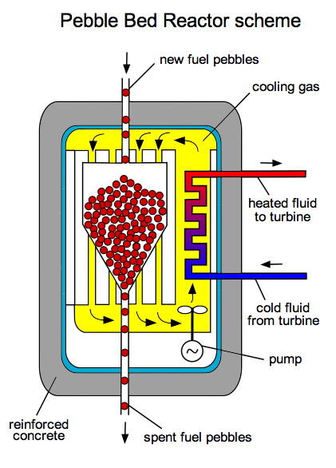
How to use thorium in practice?
Thorium blankets around fast critical reactors to breed ²³³U: the Indian approach, most advanced.
Continuously circulating fuel to always have fresh fuel in the core Pebble bed or molten salt critical reactors (MSR)
Provide extra neutrons with an accelerator: Accelerator-Driven Systems (ADS)
Pebble-bed Reactor scheme
Molten Salt Reactor scheme

Slide 8
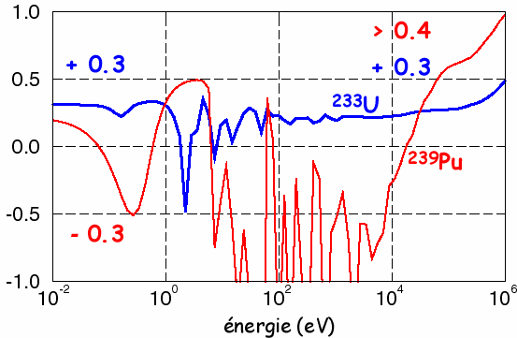
What is an Accelerator Driven System ?
A particle accelerator provides an external neutron source.
It allows to breed in the fast neutron region where breeding is not favourable compare to Pu, this in turn allows to destroy Trans Uranium elements
In addition, the accelerator allows to modulate the power (complementarity with fluctuating new renewable energies)
Breeding
possible
ε = ν – 2(1+α)
ε = Average number of neutrons in excess of the 2 neutrons needed to run the fission chain

Slide 9
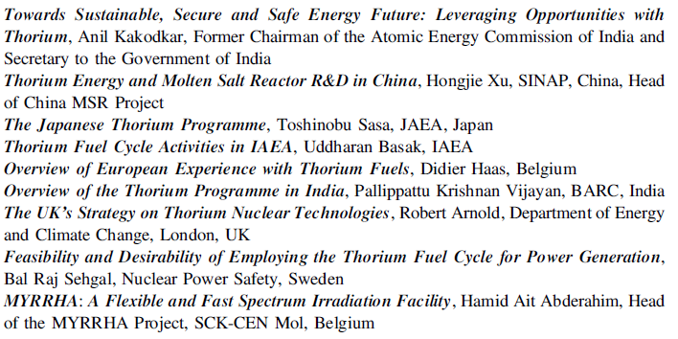
Part II: National and International Thorium Programmes
Contents:

Slide 10
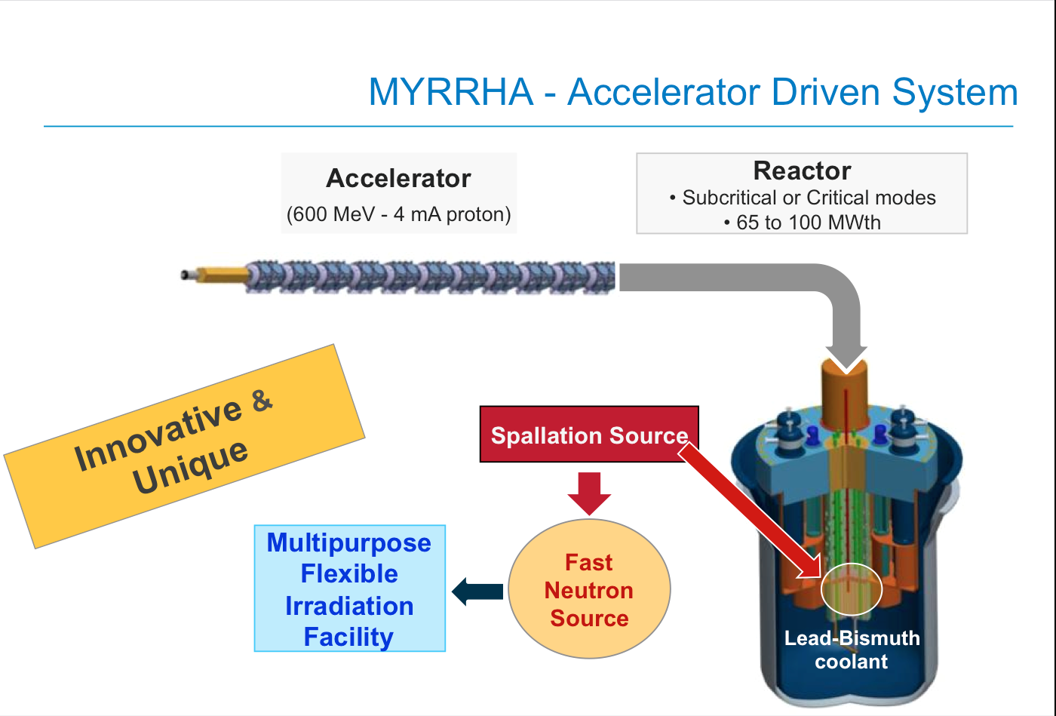
Example: presented by Aït Abderrahim)

Slide 11
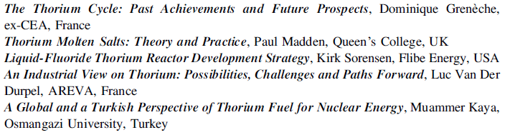
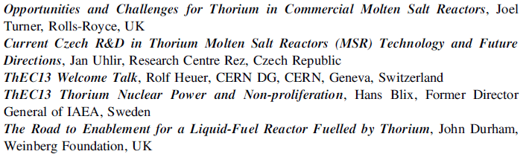
Part III: Innovative and International Reactor Concepts

Slide 12
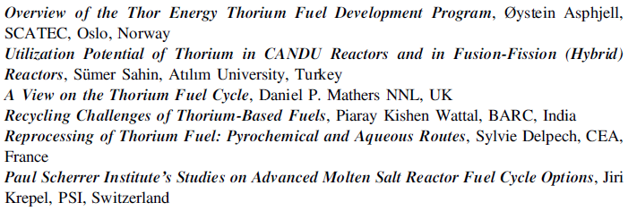
Part IV: Thorium Fuel Cycle and Transmutation

Slide 13
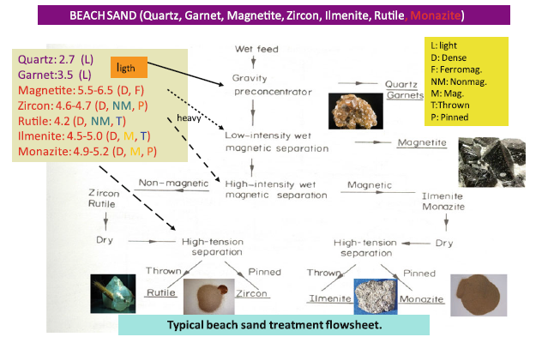
Example: A Global and a Turkish Perspective of Thorium Fuel for Nuclear Energy (Muammer Kaya)

Slide 14
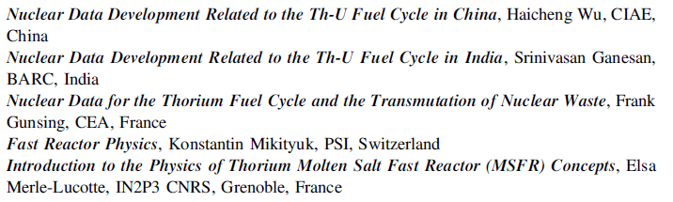
Part V: Thorium-Reactor Physics

Slide 15
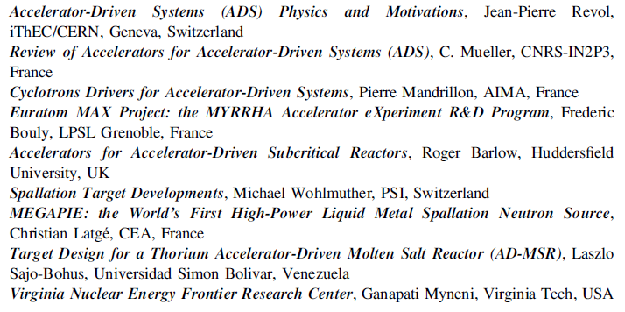
Part VI: Accelerator-Driven Systems

Slide 16
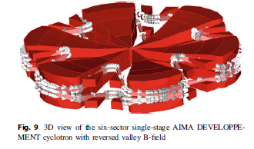
Example: Cyclotron Drivers for ADS (P. Mandrillon et al.)

Slide 17
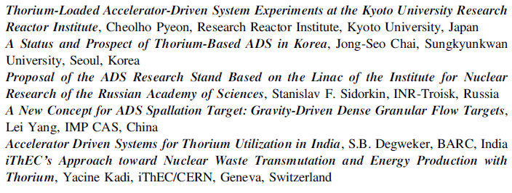
Part VI: Accelerator-Driven Systems

Slide 18
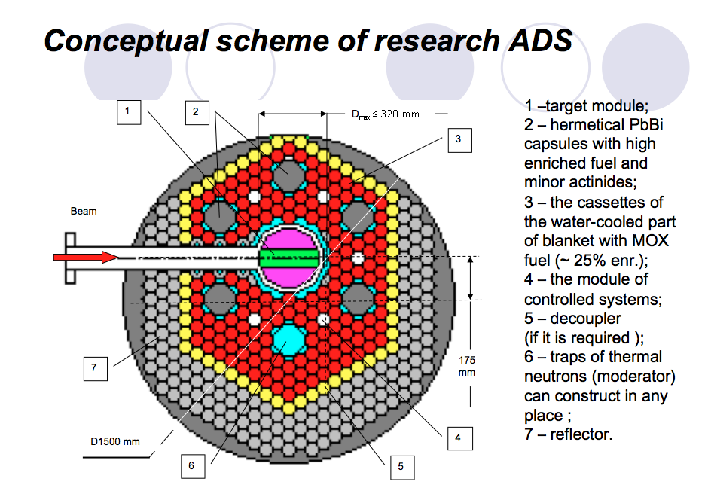
Example: An Experiment at INR Troitsk
At ThEC13 Stanislav Sidorkin presented a proposal of an ADS experiment at Troitsk, using the Moscow Meson Factory, at the Institute for Nuclear Research (INR)
iThEC recognized that it could be a realistic possibility of having an ADS experiment

Slide 19
Conclusions
Thorium promising nuclear fuel, abundant, not releasing Co2. Much R&D necessary.
These proceedings
are a reference in the domain of R&D for use of thorium and ADS.
Help fight ignorance of scientific facts and should inform scientists and learned public
Future: put some coherence in the numerous projects
Anybody with a CERN account can access the proceedings online from the Springer site:
http://link.springer.com/book/10.1007/978-3-319-26542-1

