Slide 1
Thorium-Based Systems
A new direction for nuclear waste elimination and energy production.
Maurice Bourquin
EPFL, August 28, 2018

Slide 2
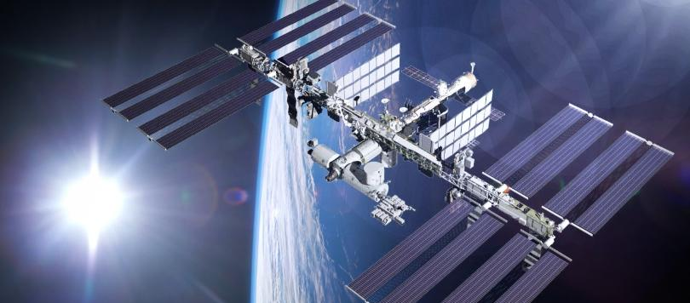
Particle Detector on the International Space Station

Slide 3
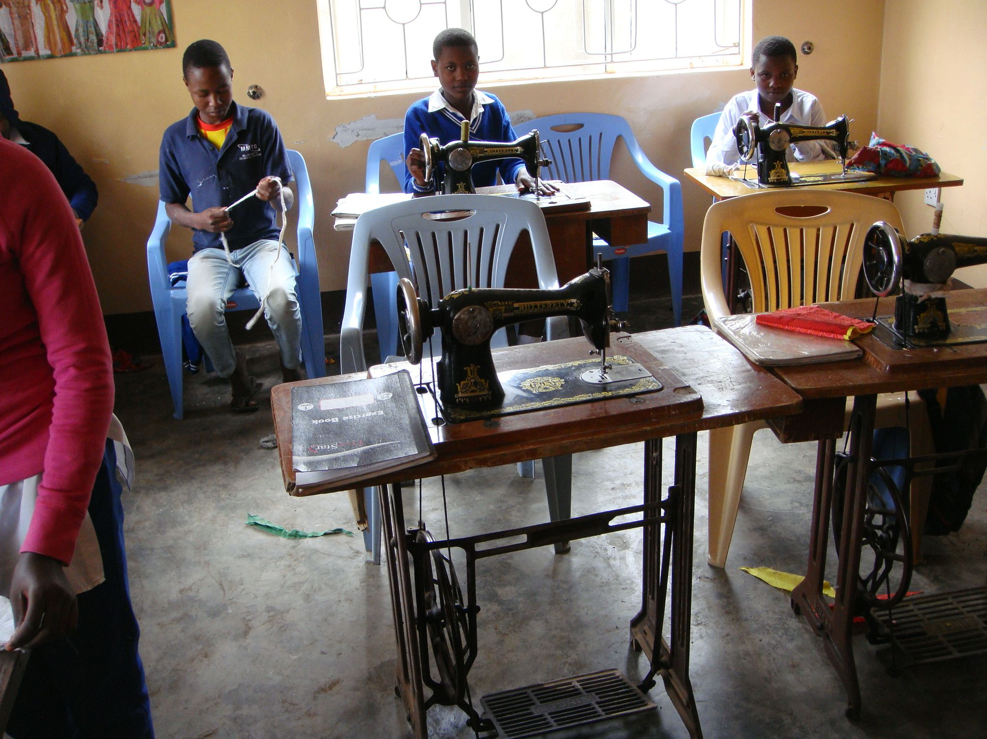
By 2050, global electricity demand is expected to increase between 120% to 150%

Slide 4
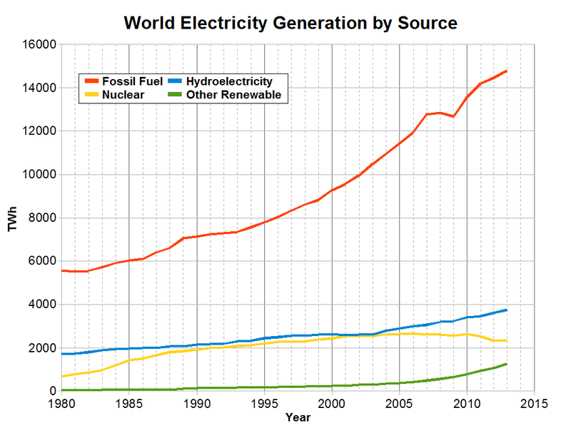
Fossil fuels and CO2 emission VS renewable energies intermittence
Fossil fuels

Slide 5
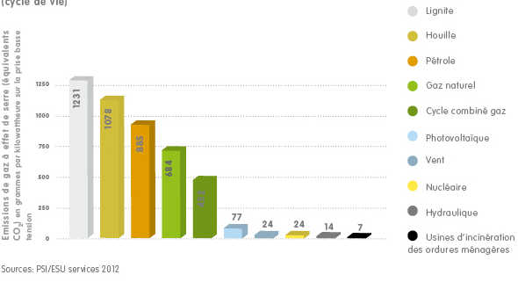
Greenhouse gas emission
Fossil fuels

Slide 6
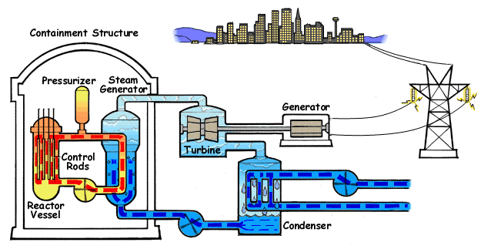
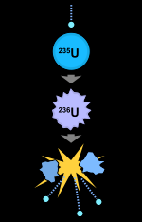
Components of a Pressurized Water Reactor
Source:Wikipedia

Slide 7
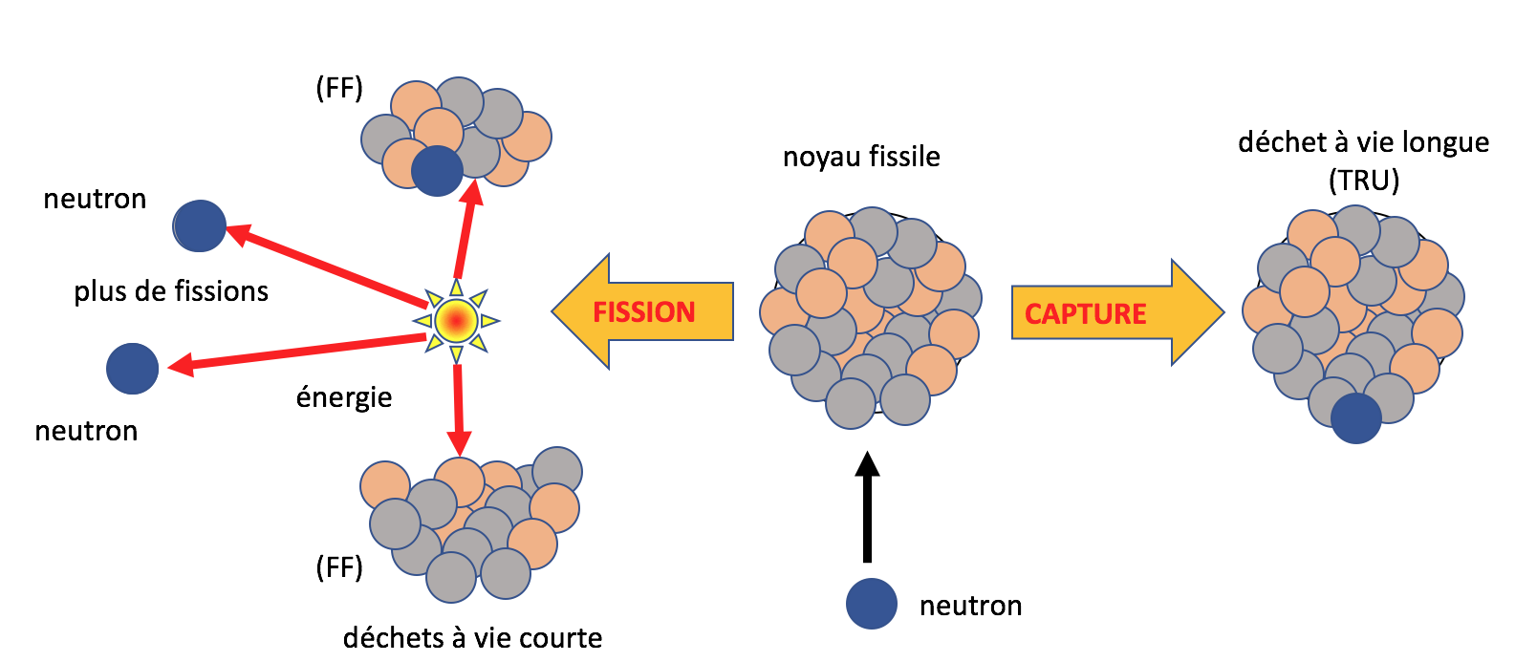
Nuclear Wastes from Used Nuclear Fuel
HLW:
Fission fragments
Transuranic elements :
plutonium, minor actinides(Np, Am, Cm…)

Slide 8
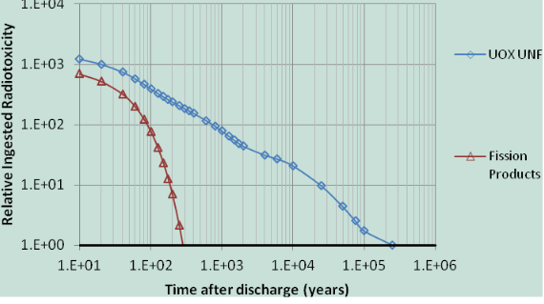
Pu and minor actinides
FP
Natural
Uranium level
Yasir Arafat et al.,
Westinghouse Electric Company

Slide 9
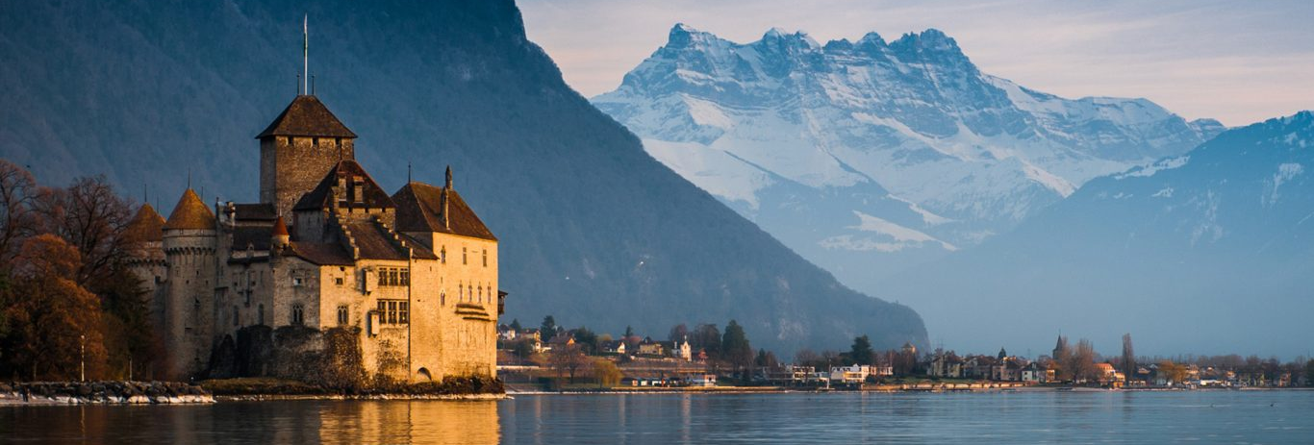
An actual solution to the impossible management of nuclear waste over thousands of years

Slide 10
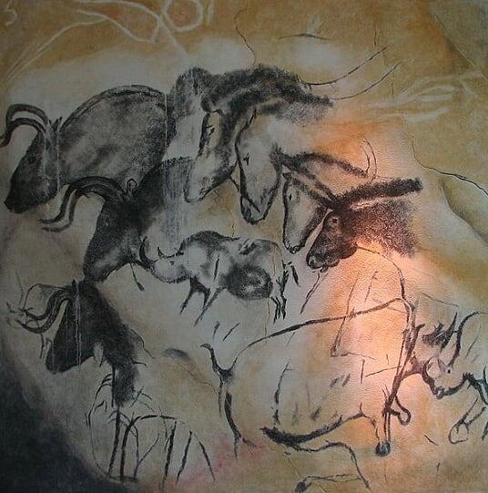
Past, present and future of the Humanity : our Earth, our heritage

Slide 11
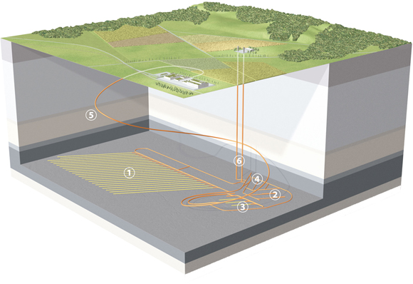
Deep Geological Repository for High-Level Waste, the Swiss example
Heat + radioactivity
Half-lives:
Strontium-90 and cesium-137 about 30 years
Plutonium-239 24,000 years, Np, Am, Cm
Image: Infel AG, Claudio Köppel

Slide 12
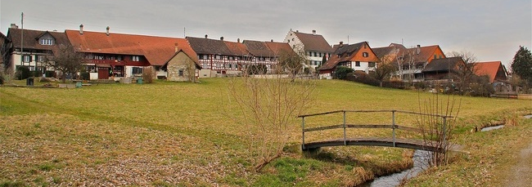
The reality of Marthalen, Zürich

Slide 13
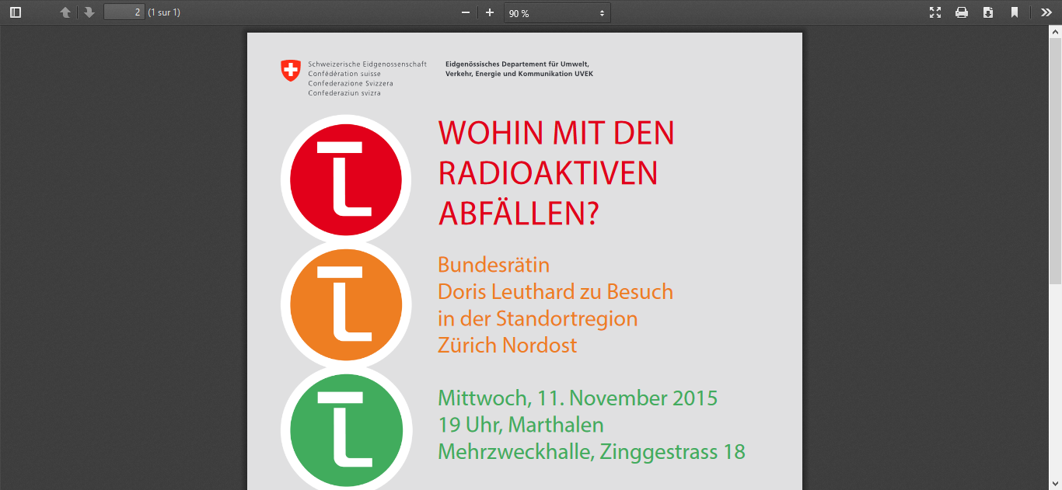
Peaceful village and radioactive waste

Slide 14
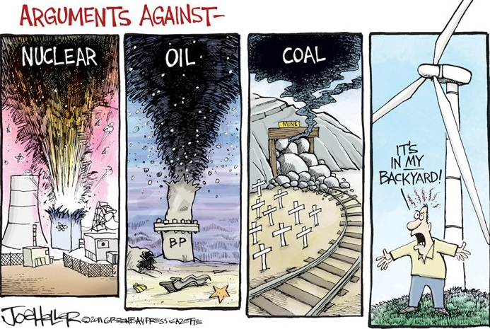

Slide 15

Energy production from E=m c²
Fission of uranium
(or plutonium)
Thorium-uranium breeder

Slide 16
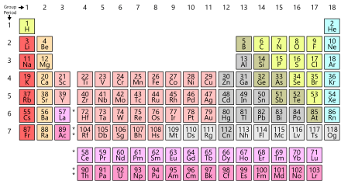
Energy production from E=m c²
thorium
uranium

Slide 17
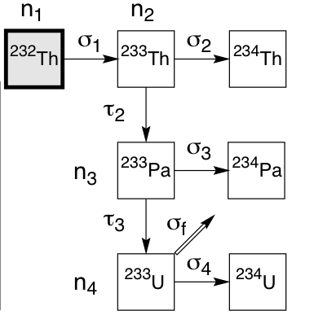
Energy production from E=m c²
Fission of uranium (or Pu)
Thorium-uranium breeder
Neutron capture
fissile
fertile
half-life
22.3 mn
half-life
27 days
half-life
26.967 days
fissile

Slide 18
Three essential benefits from using thorium over uranium
Thorium plants can run continuously for 5 to 10 years with no access to fuel
They can never have a core meltdown like in Fukushima (coolant is not water, but liquid fluoride salt or molten lead, chemically stable, and operating at atmospheric pressure).
They create much less nuclear wastes , without Pu or MA and thus can be made to fulfill the criterion of wastes lasting a maximum of 300 years

Slide 19
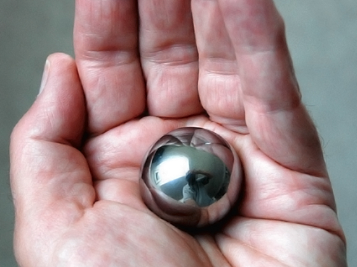

Slide 20
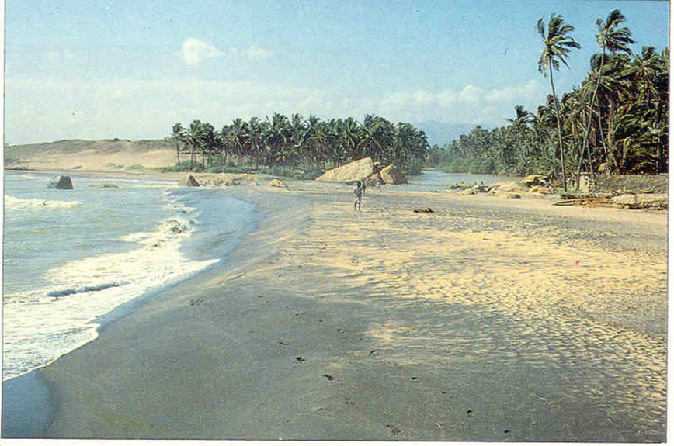
credit P.K. Wattal, BARC, India

Slide 21
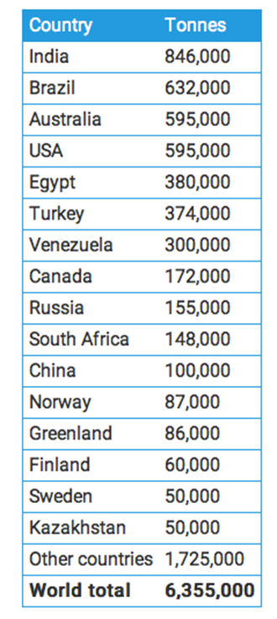
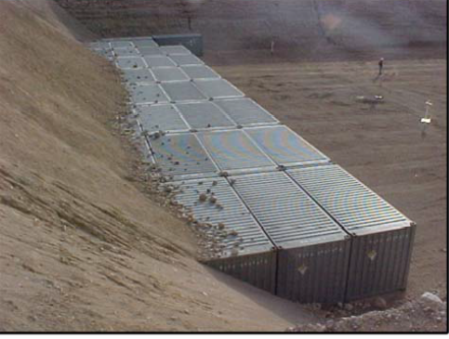
Thorium constitutes a yet unused source of energy, widely available
OECD/IAEA/Uranium 2014
Stored Containers of thorium nitrate in Nevada

Slide 22
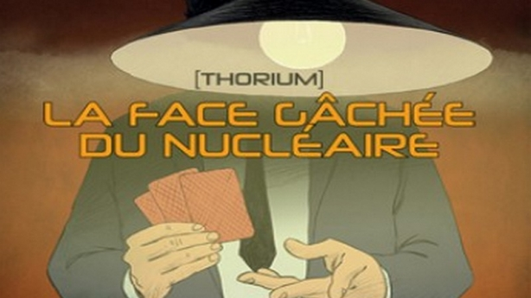
Thorium process successfully proven in Oak Ridge National Laboratory “Molten-Salt Reactor Experiment” (1960’s)
But abandoned in 1972, since the USA were more interested in producing weapons than energy.
See the documentary
produced in Germany in 2014
(Alvin Weinberg)

Slide 23
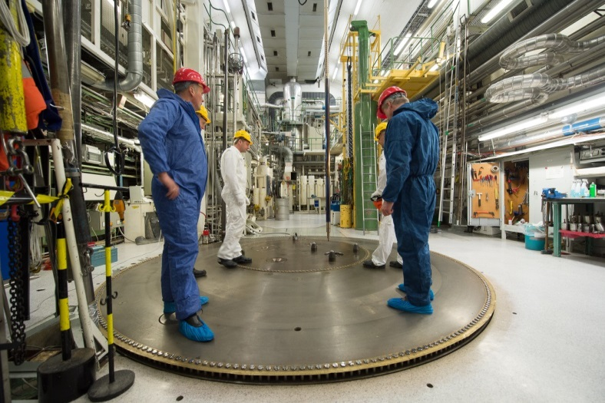

Could current water reactors be adapted for thorium fuel?
In Japan a study concludes that “all LWRs will be replaced by thorium fueled reactors within a century”.
Thor Energy (The Norwegian Thorium Initiative) collaborates with Westinghouse to carry out thorium fuel tests in the Halden research reactor.

Slide 24
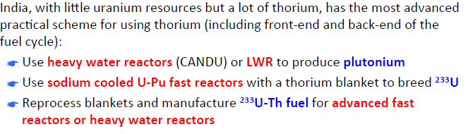
Indian Thorium Program

Slide 25
Today
The concept of Molten-Salt reactor is presently revalued in USA and China
Westinghouse in USA is developing a lead-cooled fast reactor:
“a next-generation nuclear plant with significantly improved economics, higher efficiency, and capabilities beyond electricity generation”.

Slide 26
iTHEC International Thorium Energy Committee
An association aiming at developing thorium energy systems, with a focus on Accelerator-Driven Systems.
A not for profit association, under Swiss law, founded in 2012 Engineers, scholars, politicians and other concerned citizens
Produce safe, clean and abundant energy sources, in particular in view of the huge needs of developing countries
Acting to promote R&D on the use of thorium in order to transmute long-lived nuclear waste
And produce radio-isotopes for medicine
“capabilities beyond electricity generation”.

Slide 27
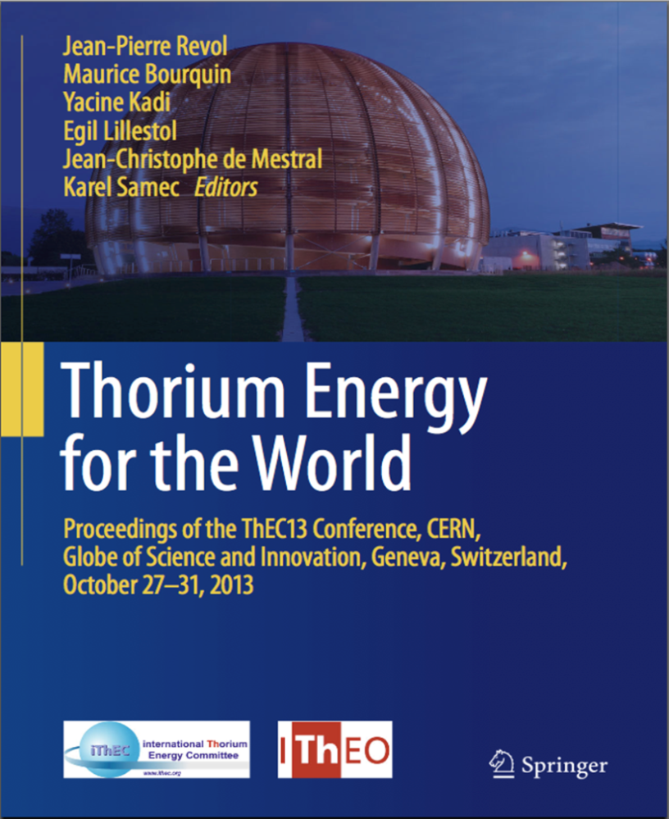
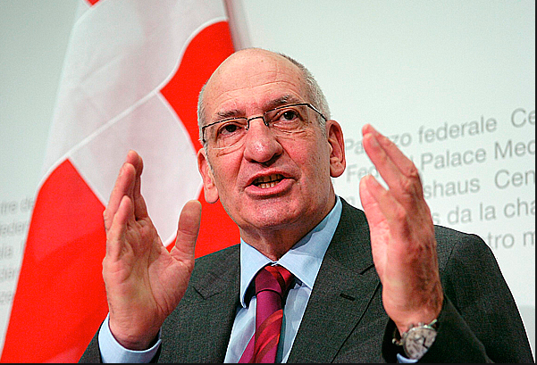
Thorium Energy for the World
«Le futur énergétique de la planète est un enjeu politique et scientifique. Les deux sont inséparables.”
www.springer.com/gb/book/9783319265407

Slide 28
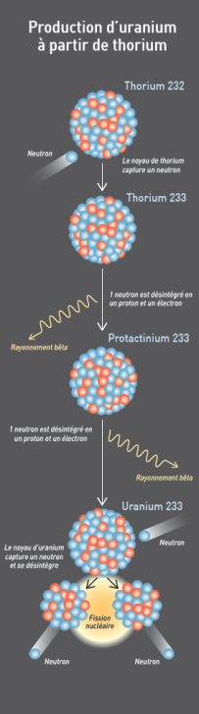
How to provide the initial neutrons?
Fission energy from ²³²Th

Slide 29
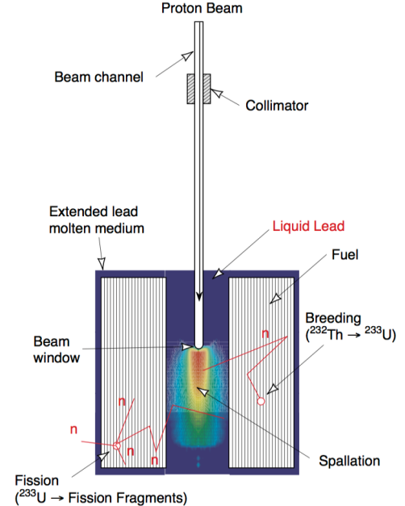
Ingenious Solution: Accelerator Driven System
A particle accelerator to provide an external neutron source from a spallation target
Fission
Spallation

Slide 30
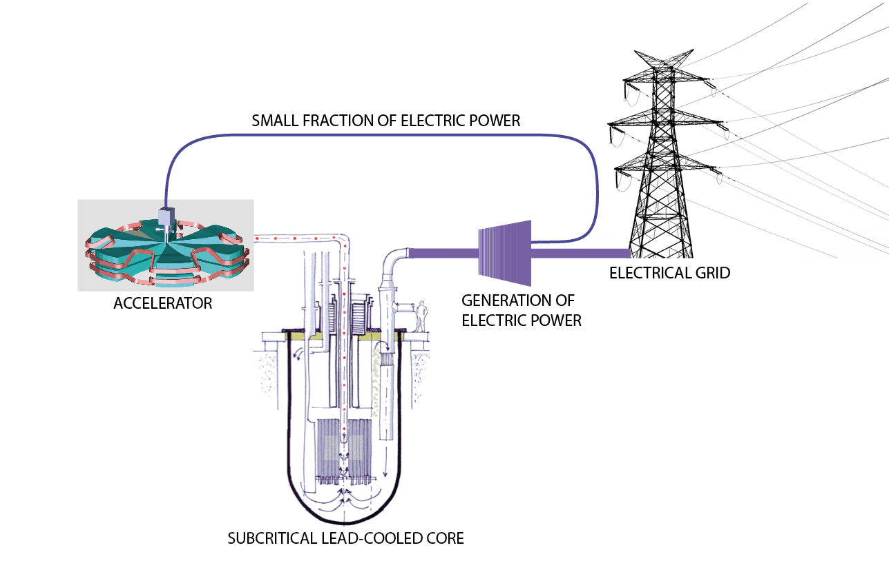

Slide 31
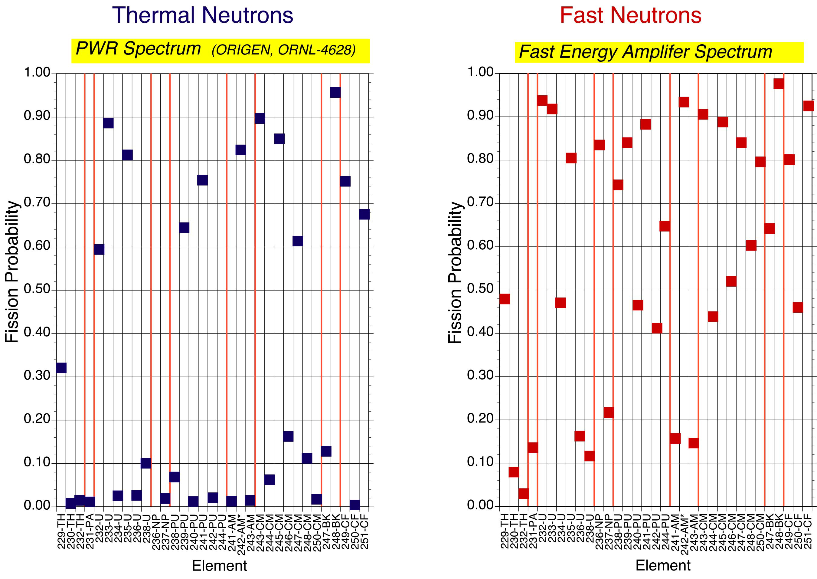
Transuranic Element Fission Probability

Slide 32
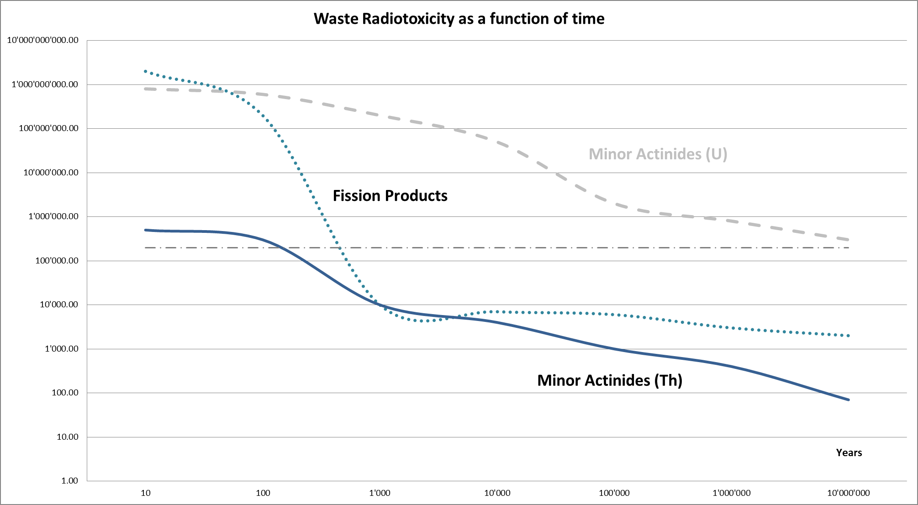
Uranium
Naturel Uranium
Thorium

Slide 33
Three Advantages of a Thorium ADS
1. Safety
Eliminate criticality accidents by making the system subcritical :inherent safety by immediate shut-down of accelerator
Operate system with passive safety elements to avoid core melting Avoid dangerous coolants such as water or liquid sodium (use lead)

Slide 34
Three Advantages of a Thorium ADS
2. Proliferation resistance
Thorium fuel has small plutonium production, and ²³³U unsuitable for weapons material (because mixed with ²³²U).
Avoid plutonium separation (Purex), use pyro-electro reprocessing instead

Slide 35
Three Advantages of a Thorium ADS
3. Waste management
Recycle long-lived transuranic actinides to minimize waste.
Eliminate by fission much of waste produced by conventional reactors

Slide 36
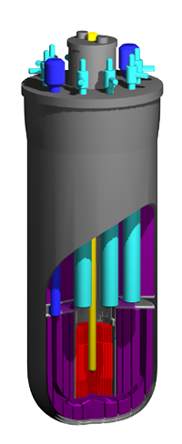
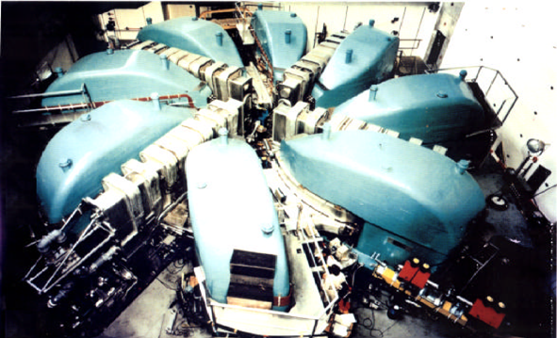
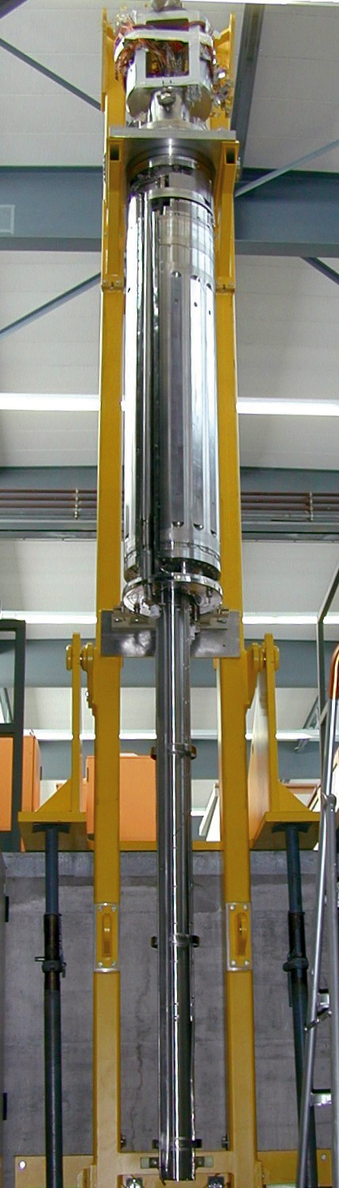
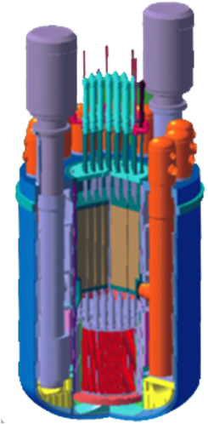
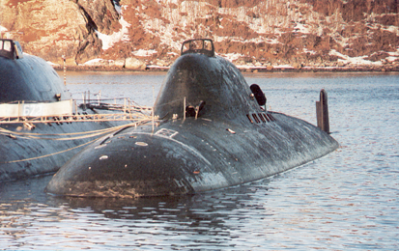
All basic elements of ADS have now been tested separately
Technology of pyrochemical reprocessing of fuel
High power accelerators technology
UO
2
2+
UO
2
+PuO
2
PuO
2
2+
Technologies of fast reactors with lead-bismuth coolant
Liquid metal targets technology

Slide 37
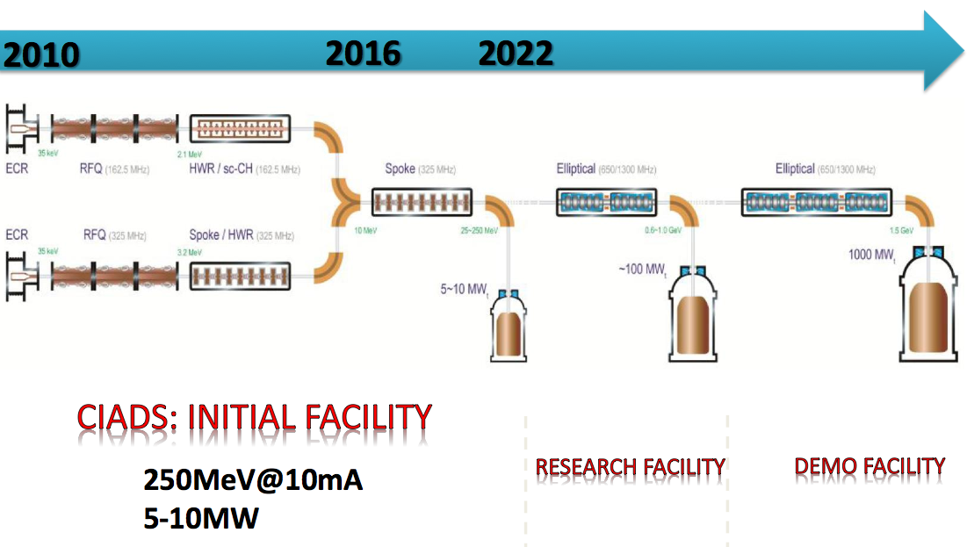
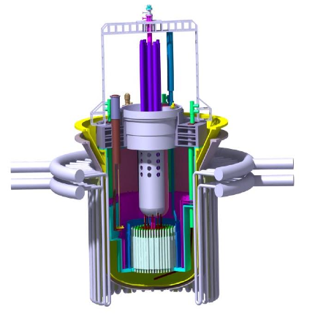
China ADS: ADANES
IMP, Lanzhou
The Chinese Accelerator-Driven Advanced Nuclear Energy System includes the accelerator, the target and the thorium blanket.
100MW
1000MW
5-10MW

Slide 38
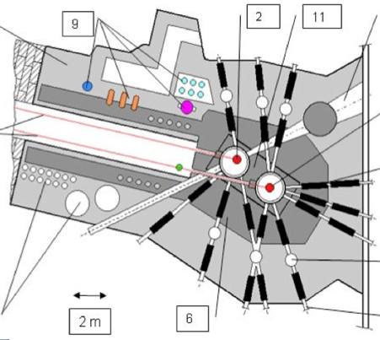
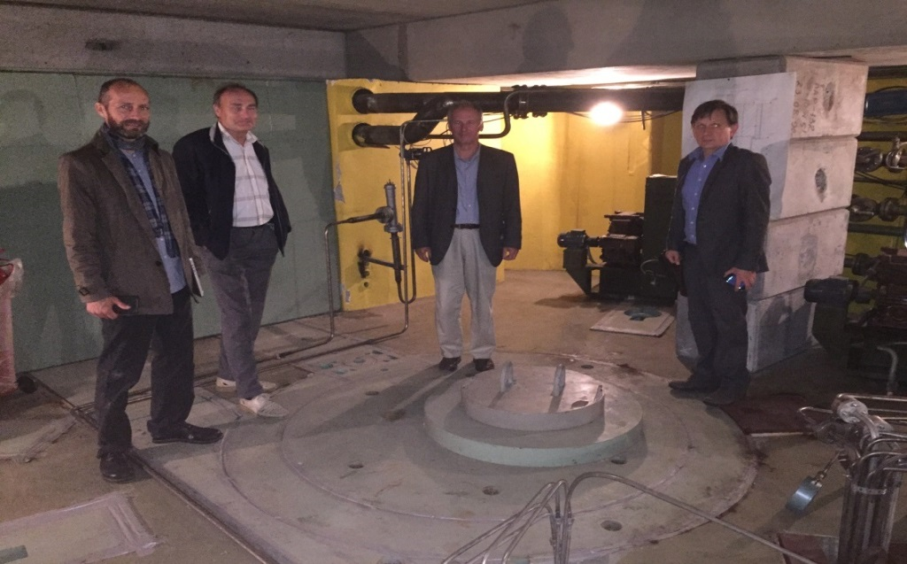
An ADS experiment using thorium fuel at significant power at INR Moscow
ADS experimental cell
The existing INR Infrastructure
– proton linear accelerator (≤600 MeV, ≤ 300kW)
– Spallation neutron source
– Pit on a beam line to receive a subcritical core
– Infrastructure to manipulate highly radioactive material)

Slide 39
Active R&D on ADS Transmutation in Europe?
EU is considering including transmutation of nuclear waste in its next EURATOM period :
Switzerland should support!
Accelerator labs (CERN, PSI, DESY…) could support
«A mission to prove the feasibility of significantly reducing the volume and radiotoxicity of dangerous long-lived isotopes in a socially acceptable and economically sustainable way» .

Slide 40
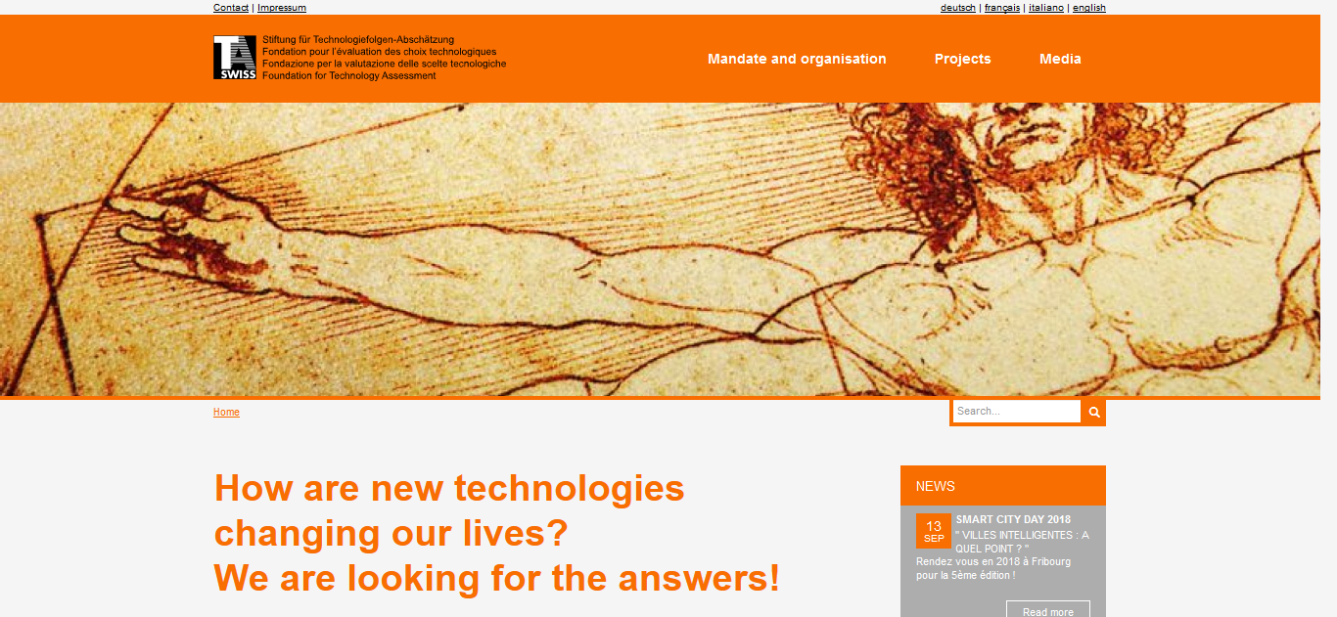
In Switzerland
TA-Swiss could perform a study on
the potential for the development of nuclear technologies with thorium

Slide 41
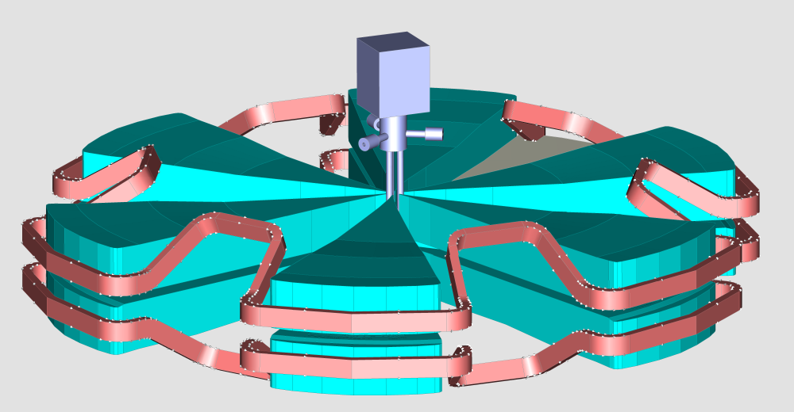

The accelerator: a key in the strategy
Innovative design: compactness, efficiency ,reliability, lower cost
CYCLADS Consortium
AIMA Developpement
ASG Superconductors
CERN
ENEA
HNE
INFN Catania & Genova
iThEC
N-21
PSI

Slide 42
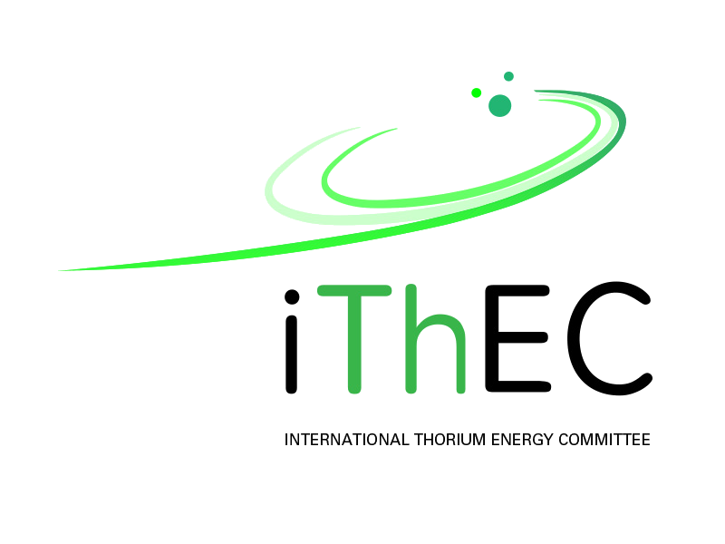
Conclusions
Stockpiles of spent nuclear fuel are huge and on the rise.
Disposal of such waste in geological sites requires safe storage for hundreds of thousands of years
Research on thorium-based Accelerator-Driven Systems should be supported.
Maurice.Bourquin@unige.ch

Slide 43

Thank you ....
Questions ?

